Slide 1

NVIDIA Stock Analysis
Hasnain Shinwari & Muhammad Zaid Khan

Slide 2
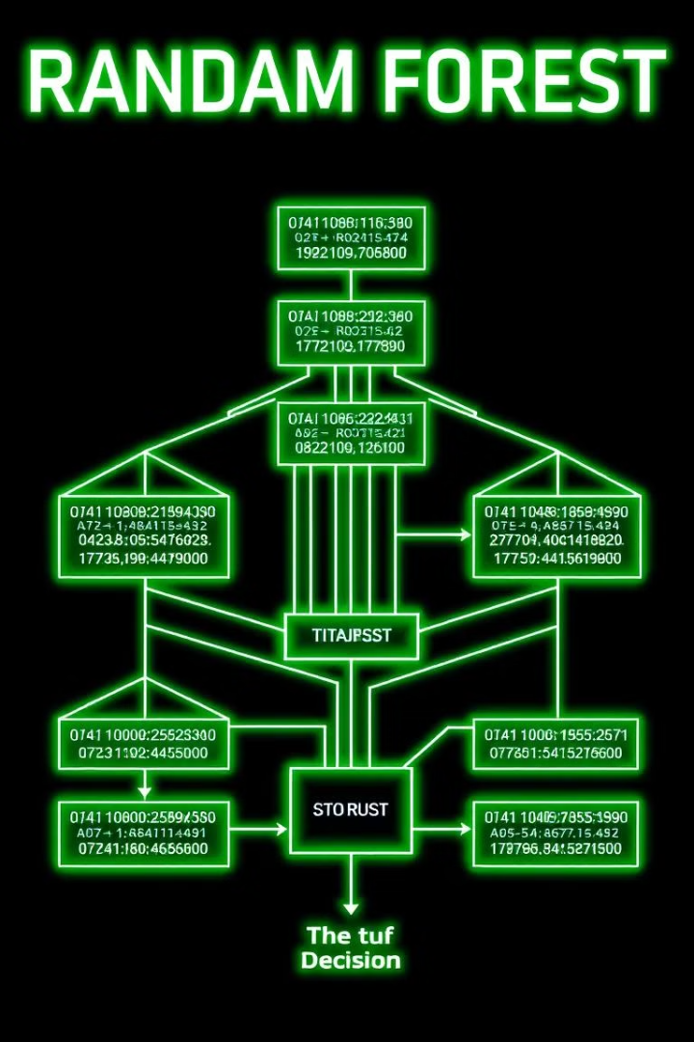
Random Forest Classification Model
Random Forest classification is a supervised learning algorithm that utilizes multiple decision trees for classification tasks. The model aggregates the predictions of individual trees to achieve a more robust and accurate classification result.

Slide 3
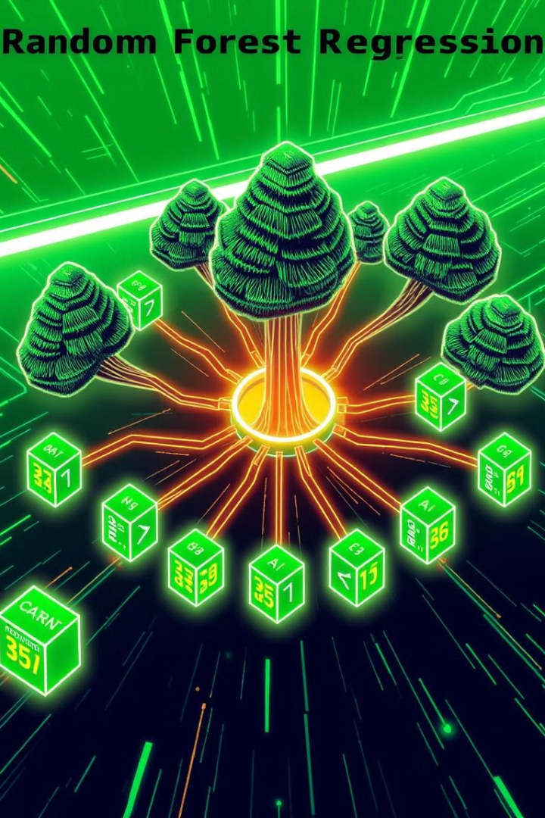
Random Forest Regression Model
Random Forest regression is a powerful tool for predicting continuous variables by leveraging the collective wisdom of multiple decision trees. This ensemble model averages the predictions of individual trees to produce a more accurate and reliable estimate.

Slide 4

K-Means Clustering Model
K-Means clustering is an unsupervised learning algorithm used to group data points into clusters based on their similarity. The model aims to find the optimal cluster centroids and assign data points to the nearest centroid, creating distinct groups of data points.

Slide 5
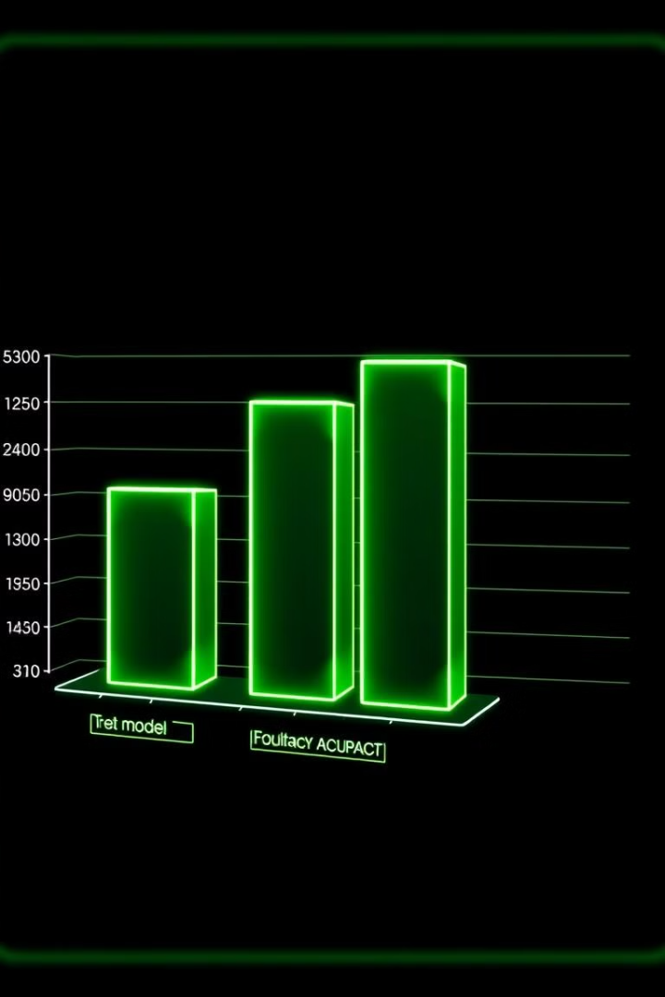
Accuracy of the Models
Classification
Regression
65% accuracy
96% accuracy
Clustering
59% accuracy

Slide 6
Key Takeaways
1
Strong Regression
2
Room for Improvement
3
Continued Exploration
The regression model achieved a high accuracy, indicating its potential for predicting Nvidia stock prices with considerable confidence.
The classification and clustering models require further refinement to improve their performance and accuracy.
The findings underscore the importance of continued research and development in these areas to enhance model capabilities.

Slide 7
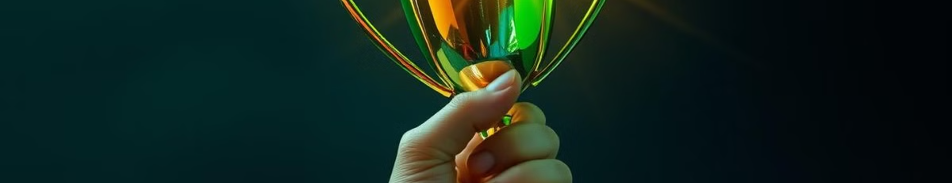
Thank You

